Slide 1
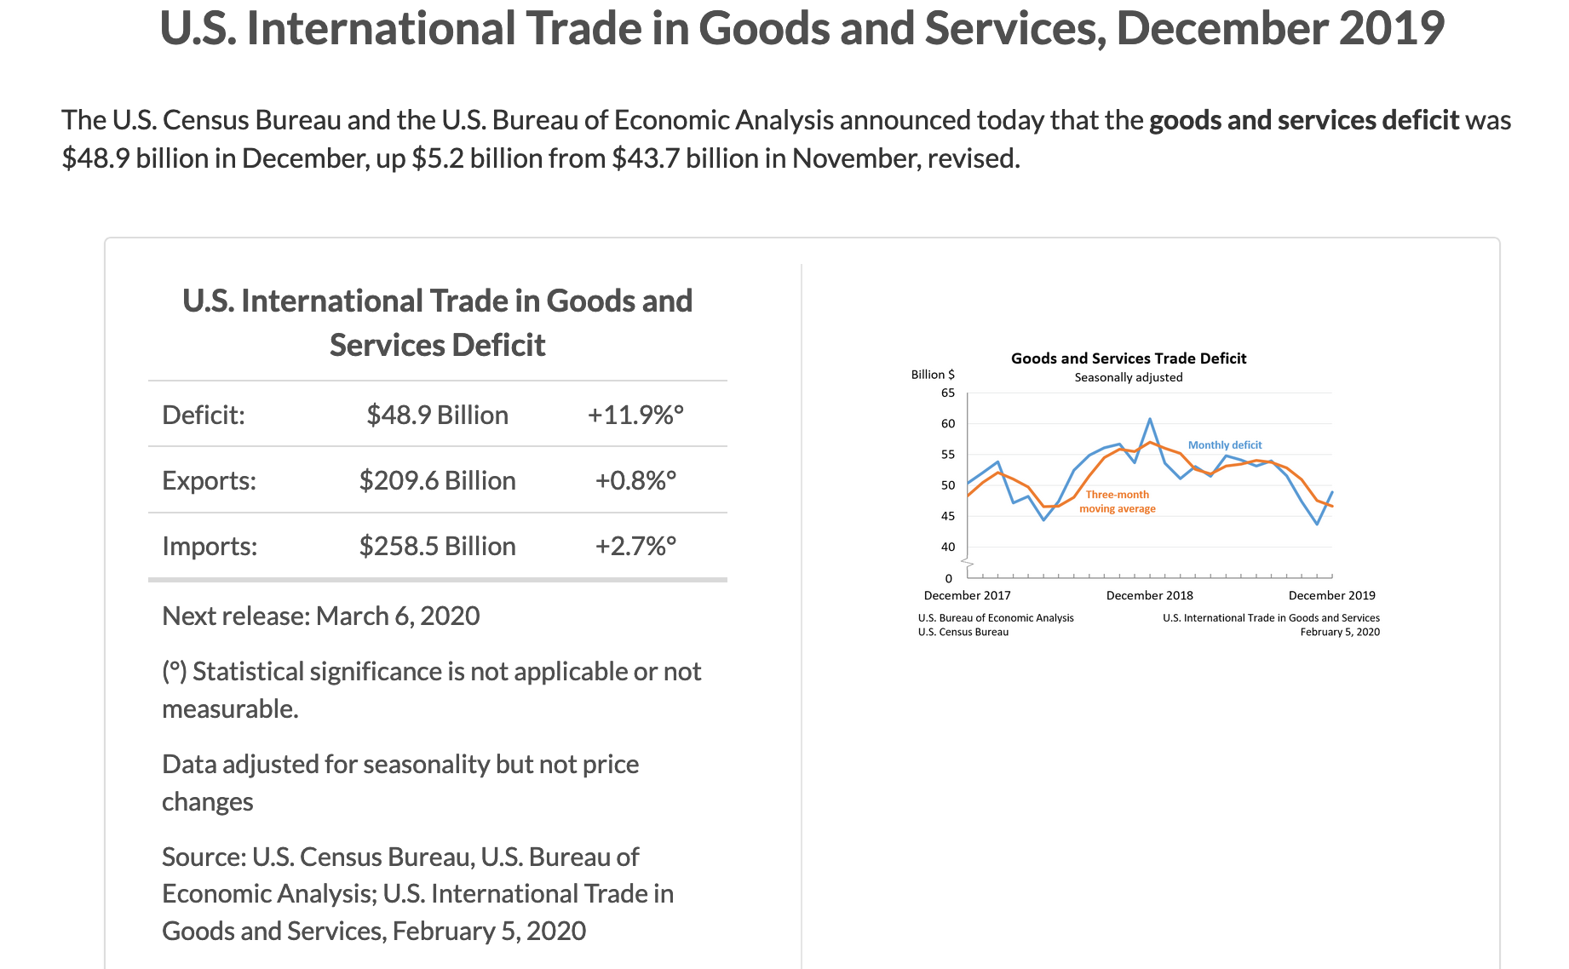
BEA (02/05/2020)
https://www.bea.gov/news/2020/us-international-trade-goods-and-services-december-2019

Slide 2
Ch. 28
Unemployment

Slide 3
Look for the answers to these questions:
How is unemployment measured?
What is the “natural rate of unemployment”?
Why are there always some people unemployed?
How is unemployment affected by unions and minimum wage laws?
What is the theory of efficiency wages, and how does it help explain unemployment?

Slide 4
Labor Force Statistics
Produced by Bureau of Labor Statistics (BLS), in the U.S. Dept. of Labor
Based on regular survey of 60,000 households
Based on “adult population” (16 yrs or older)
Notes:
BLS also produces the CPI statistics.

Slide 5
Labor Force Statistics
Labor force = Employed + Unemployed
BLS divides population (16 yrs or older) into 3 groups:
Employed: paid employees, self-employed, and unpaid workers in a family business, full-time and part-time workers
Unemployed: people not working who have looked for work during previous 4 weeks
Not in the labor force: everyone else
Notes:
Good idea:
Tell students to take good notes on this slide and the following one, because in a moment they will have to use these definitions to solve a problem. You can tell them the problem is very similar to what they might see on their next exam—that always gets their attention!

Slide 6
Labor Force Statistics
Not in the labor force:
Diusscouraged workers would like to work but have given up looking for jobs
- classified as “not in the labor force” rather than “unemployed.”
Notes:
Good idea:
Tell students to take good notes on this slide and the following one, because in a moment they will have to use these definitions to solve a problem. You can tell them the problem is very similar to what they might see on their next exam—that always gets their attention!

Slide 7
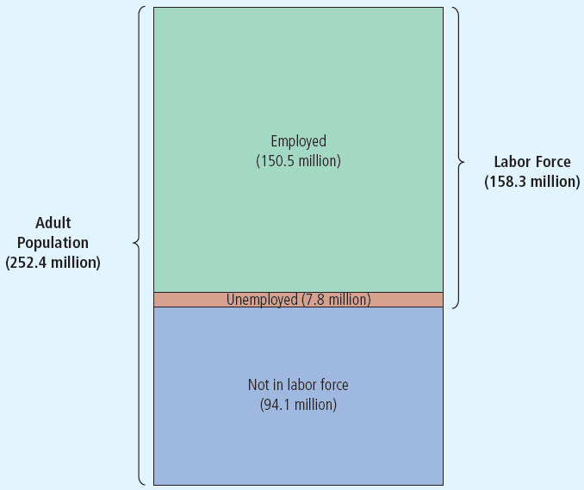
Figure 1 The Breakdown of the Population in January 2016
The Bureau of Labor Statistics divides the adult population into three categories: employed, unemployed, and not in the labor force.

Slide 8
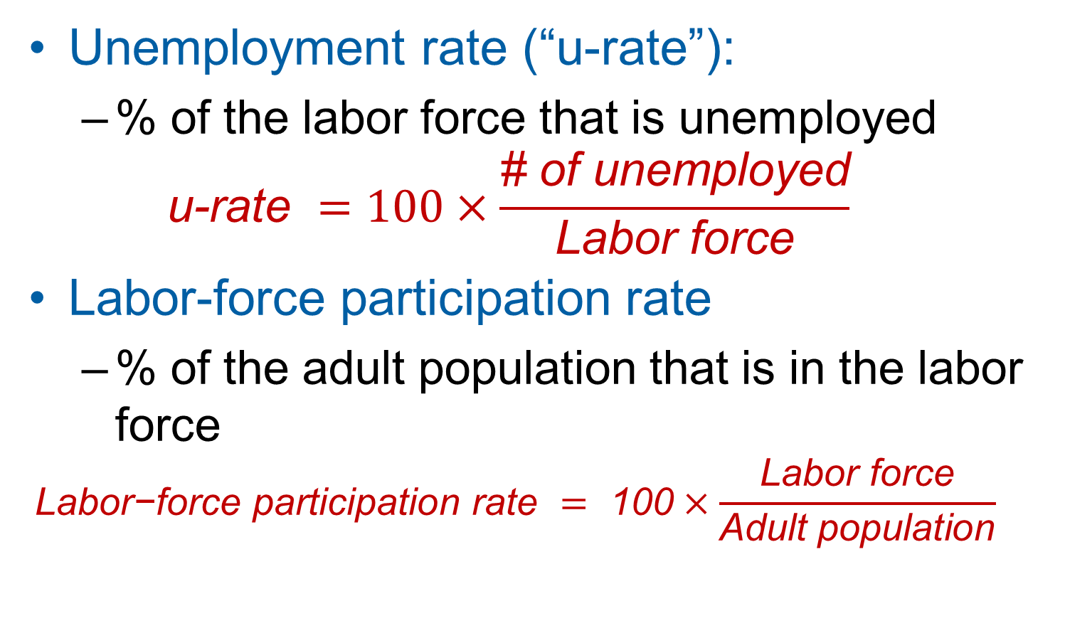
Labor Force Statistics
Unemployment rate (“u-rate”):
% of the labor force that is unemployed
$$\text{u}\text{−}\text{rate} =100×\frac{\text{\# }\text{of} \text{unemployed}}{\text{Labor} \text{force}}$$
Labor-force participation rate
% of the adult population that is in the labor force
$$\text{Labor}\text{−}\text{force} \text{participation} \text{rate} = \text{100}×\frac{\text{Labor} \text{force}}{\text{Adult} \text{population}}$$
Notes:
Many of the following slides abbreviate “unemployment rate” as “u-rate” to reduce slide clutter and to reduce the note-taking burden on students.

Slide 9
Active Learning 1 Calculate labor force statistics
Compute the labor force, u-rate, adult population, and labor force participation rate using this data:
Adult population of the U.S. by group, Dec 2019
# of employed | 158.8 million
# of unemployed | 5.8 million
not in labor force | 95.7 million
Notes:
This exercise gives students immediate reinforcement and application of the concepts on the preceding slides. It prepares them for some of the kinds of questions they might see on your exam. And it gives them a sense of the actual magnitude of these statistics in the U.S. in a recent month.
Suggestion: Before lecturing on this chapter, update the numbers in this table (and in the answers that follow) using the latest available data, which you can find here:
Data source: Bureau of Labor Statistics, U.S. Department of Labor
http://www.bls.gov, look for latest “Employment Situation Summary”
http://www.bls.gov/news.release/empsit.nr0.htm (Table A-1)

Slide 10
Adult population of the U.S. by group, Dec 2019
# of employed | 158.8 million
# of unemployed | 5.8 million
not in labor force | 95.7 million
Labor force
Unemployment Rate (U-rate)
Population
LF partic. Rate
Notes:
This exercise gives students immediate reinforcement and application of the concepts on the preceding slides. It prepares them for some of the kinds of questions they might see on your exam. And it gives them a sense of the actual magnitude of these statistics in the U.S. in a recent month.
Suggestion: Before lecturing on this chapter, update the numbers in this table (and in the answers that follow) using the latest available data, which you can find here:
Data source: Bureau of Labor Statistics, U.S. Department of Labor
http://www.bls.gov, look for latest “Employment Situation Summary”
http://www.bls.gov/news.release/empsit.nr0.htm (Table A-1)

Slide 11
Labor Force Statistics for Different Groups
The BLS publishes these statistics for demographic groups within the population.
These data reveal widely different labor market experiences for different groups.
Notes:
If you need to get through this chapter more quickly, you might consider omitting some of the following slides. However, I recommend that you keep the slide showing unemployment rates by education level—it is excellent motivation for students to complete their degree program!

Slide 12
Labor Force Statistics for Whites & Blacks, June 2016
0
Adults (20 yrs & older)
 | u-rate | LF part. rate
White, male | 4.0% | 71.9%
White, female | 4.0 | 57.6
Black, male | 8.2 | 67.8
Black, female | 7.3 | 60.9
Notes:
12
Within either racial group, males have higher participation rates than females.
Blacks have far higher unemployment rates than whites. This is of great concern to many economists and policymakers.
Source: Bureau of Labor Statistics, U.S. Department of Labor
www.bls.gov, look for latest “employment situation”
http://www.bls.gov/news.release/empsit.nr0.htm (Table A2-)
http://www.bls.gov/news.release/empsit.t02.htm

Slide 13
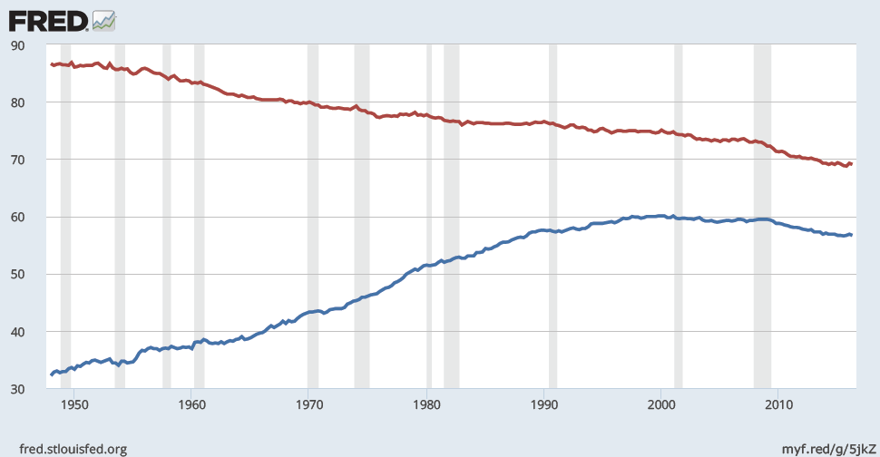
LF Participation Rates by Sex, 1948–2016
male
percent
female
Notes:
The male LF participation rate is males in the labor force as a percentage of all males. Similarly for females.
The vertical axis starts at 30 rather than 0 to make the trends more apparent.
Since 1950, female participation has nearly doubled—from 34% to 56.7%. Male participation has declined from 86% to 68.7%.
If you can spare a few minutes for class discussion, ask your students two questions:
1) What factors do you think have caused these trends? The textbook offers some explanations; see the Case Study entitled “Labor Force Participation of Men and Women in the U.S. Economy.”
2) What are some of the effects or consequences of these trends?
There is a case study in the textbook, ‘Labor-force participation of men and women in the U.S. economy’ that explains these trends.
Source: Same as textbook. For the newest data, use the following link: https://fred.stlouisfed.org/graph/fredgraph.png?g=5jkQ
Source: US. Bureau of Labor Statistics, Civilian Labor Force Participation Rate: Men [LNS11300001], and Civilian Labor Force Participation Rate: Women [LNS11300002], retrieved from FRED, Federal Reserve Bank of St. Louis; https://fred.stlouisfed.org/series/LNS11300001, https://fred.stlouisfed.org/series/LNS11300002, July 10, 2016.

Slide 14
Active Learning 2 Limitations of the u-rate
In each of the following, what happens to the u-rate? Does the u-rate give an accurate impression of what’s happening in the labor market?
Sue lost her job and begins looking for a new one.
Jon, a steelworker who has been out of work since his mill closed last year, becomes discouraged and gives up looking for work.
Sam, the sole earner in his family of 5, just lost his $80,000 job as a research scientist. Immediately, he takes a part-time job at McDonald’s until he can find another job in his field.
Notes:
The objective of this exercise is to lead students to discover why the unemployment rate is not a perfect indicator of joblessness.
It might be helpful to tell students to determine the impact on the u-rate, no matter how tiny. I.e., if one person becomes unemployed, the u-rate will rise, but ignore the fact that, if this happened in the real world, the increase in the aggregate u-rate would be too small to matter.

Slide 15
What Does the U-Rate Really Measure?
The u-rate:
Not a perfect indicator of joblessness or the health of the labor market
It excludes discouraged workers.
It does not distinguish between full-time and part-time work, or people working part time because full-time jobs not available.
Some people misreport their work status
Still a very useful barometer of the labor market & economy.
Notes:
If you choose to skip the preceding exercise, you’ll need to give students a definition of the term “discouraged worker.”
This slide recaps the lessons from the preceding exercise and mentions an additional point from the text: people may misreport their labor market status to the BLS, perhaps because they think it will help them get public assistance. This also makes the unemployment rate a bit less accurate.
You might remind students that, in earlier chapters, we learned that other macroeconomic indicators were imperfect: GDP is an imperfect indicator of society’s well-being, and the CPI tends to overstate increases in the cost of living. Yet, the unemployment rate remains highly useful. For example, when the unemployment rate rises, it is almost always true that things are getting worse in the labor market.
The BLS computes other measures of joblessness, such as (unemployed plus discouraged workers) as a percentage of (the labor force plus discouraged workers). For more details, refer your students to Table 2 in this chapter of the textbook.

Slide 16
The Duration of Unemployment
Most spells of unemployment are short:
Typically 1/3 of the unemployed have been unemployed under 5 weeks, nearly 2/3 have been unemployed under 14 weeks.
Only 20% have been unemployed over 6 months.
Notes:
The data under the first bullet point come from the BLS (www.bls.gov), the employment situation survey.
Some students think the two facts on this slide contradict each other. The book gives a simple example that helps students understand how these facts can both be true.
These facts imply that economists and policymakers must be careful when interpreting data on unemployment and designing policies to help the unemployed.

Slide 17
The Duration of Unemployment
Yet, most observed unemployment is long term.
The small group of long-term unemployed persons has fairly little turnover, so it accounts for most of the unemployment observed over time.
Knowing these facts helps policymakers design better policies to help the unemployed.

Slide 18
3 Types of Unemployment
Cyclical unemployment
Frictional unemployment
Structural unemployment
Notes:
Unemployment is a serious and complicated problem with a variety of causes. To most effectively address such a problem, we need to break it down and look at each cause separately.
We begin by noting that the causes of short-run fluctuations in unemployment are different than the causes of the long-run average unemployment rate, called the “natural rate of unemployment.”
The next slide shows U.S. data on both since 1960.

Slide 19
3 Types of Unemployment
1. Cyclical unemployment
Associated with business cycles, which we’ll study in later chapters
2. Frictional unemployment
Occurs when workers spend time searching for the jobs that best suit their skills and tastes
Short-term for most workers
3. Structural unemployment
- Occurs when the number of jobs available in come labor markets is insufficient to provide a job for everyone who wants
Occurs when there is a mismatch between what companies need and workers can offer
Usually longer-term
Notes:
Unemployment is a serious and complicated problem with a variety of causes. To most effectively address such a problem, we need to break it down and look at each cause separately.
We begin by noting that the causes of short-run fluctuations in unemployment are different than the causes of the long-run average unemployment rate, called the “natural rate of unemployment.”
The next slide shows U.S. data on both since 1960.

Slide 20
3 Types of Unemployment
Even when the economy is doing well, there is always some unemployment, including:
Frictional unemployment
Structural unemployment
Notes:
In later chapters, we will study short-run economic fluctuations and learn more about the causes and possible cures of cyclical unemployment. For the rest of this chapter, our job is understanding the various causes of the natural rate of unemployment.
* * WARNING: If you are teaching with Mankiw for the first time, please note that his definition of structural unemployment may be different than the definition you’ve seen in other textbooks.
Other books commonly define structural unemployment as arising from a mismatch between the skills or locations of workers and the skill requirements or locations of jobs. Such textbooks assert that such unemployment results from sectoral shifts.
Mankiw’s position is as follows: If all wages were flexible, then they would adjust after structural changes so that all workers with any given skill set in any given location would be employed. The cause of “structural unemployment” therefore cannot be changes in the structure of demand and production; the cause must be wages that fail to adjust following these changes.

Slide 21
Natural Rate of Unemployment
Natural (normal) rate of unemployment
The level of unemployment at which there is no cyclical unemployment.
It consists of only frictional and structural unemployment.
Cyclical unemployment
Deviation of unemployment from its natural rate
https://www.federalreserve.gov/faqs/economy_14424.htm
Notes:
In later chapters, we will study short-run economic fluctuations and learn more about the causes and possible cures of cyclical unemployment. For the rest of this chapter, our job is understanding the various causes of the natural rate of unemployment.
* * WARNING: If you are teaching with Mankiw for the first time, please note that his definition of structural unemployment may be different than the definition you’ve seen in other textbooks.
Other books commonly define structural unemployment as arising from a mismatch between the skills or locations of workers and the skill requirements or locations of jobs. Such textbooks assert that such unemployment results from sectoral shifts.
Mankiw’s position is as follows: If all wages were flexible, then they would adjust after structural changes so that all workers with any given skill set in any given location would be employed. The cause of “structural unemployment” therefore cannot be changes in the structure of demand and production; the cause must be wages that fail to adjust following these changes.

Slide 22
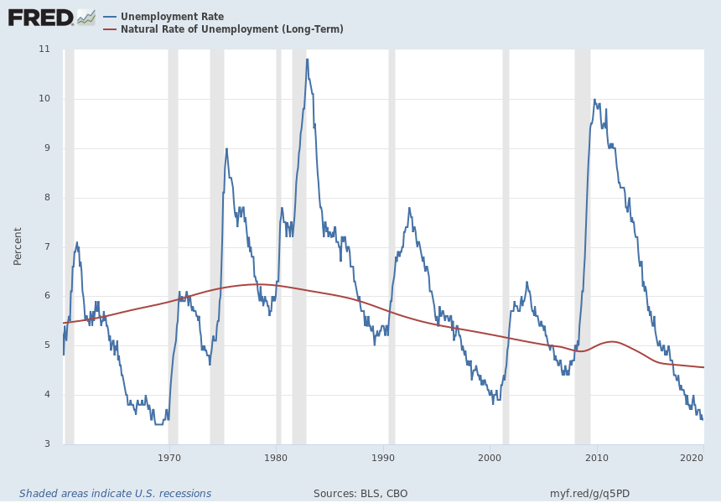
US Unemployment, 1960–2019
Unemployment rate
Natural rate of unemployment
Notes:
Source: U.S. Bureau of Labor Statistics Release: Employment Situation Units: Percent, Seasonally Adjusted Frequency: Monthly The unemployment rate represents the number of unemployed as a percentage of the labor force. Labor force data are restricted to people 16 years of age and older, who currently reside in 1 of the 50 states or the District of Columbia, who do not reside in institutions (e.g., penal and mental facilities, homes for the aged), and who are not on active duty in the Armed Forces. This rate is also defined as the U-3 measure of labor underutilization. The series comes from the 'Current Population Survey (Household Survey)' The source code is: LNS14000000 U.S. Bureau of Labor Statistics, Unemployment Rate [UNRATE], retrieved from FRED, Federal Reserve Bank of St. Louis; https://fred.stlouisfed.org/series/UNRATE, February 5, 2020. Source: U.S. Congressional Budget Office Release: Budget and Economic Outlook Units: Percent, Not Seasonally Adjusted Frequency: Quarterly The natural rate of unemployment (NAIRU) is the rate of unemployment arising from all sources except fluctuations in aggregate demand. Estimates of potential GDP are based on the long-term natural rate. (CBO did not make explicit adjustments to the short-term natural rate for structural factors before the recent downturn.) The short-term natural rate incorporates structural factors that are temporarily boosting the natural rate beginning in 2008. The short-term natural rate is used to gauge the amount of current and projected slack in labor markets, which is a key input into CBO's projections of inflation. U.S. Congressional Budget Office, Natural Rate of Unemployment (Long-Term) [NROU], retrieved from FRED, Federal Reserve Bank of St. Louis; https://fred.stlouisfed.org/series/NROU, February 5, 2020.

Slide 23
Unemployment Rate and Natural Rate of Unemployment rate (2018-2019)
 | U-Rate | Natura Rate
2018-01-01 | 4.1 | 4.597
2018-02-01 | 4.1
2018-03-01 | 4.0
2018-04-01 | 4.0 | 4.592
2018-05-01 | 3.8
2018-06-01 | 4.0
2018-07-01 | 3.8 | 4.587
2018-08-01 | 3.8
2018-09-01 | 3.7
2018-10-01 | 3.8 | 4.582
2018-11-01 | 3.7
2018-12-01 | 3.9
2019-01-01 | 4.0 | 4.577
2019-02-01 | 3.8
2019-03-01 | 3.8
2019-04-01 | 3.6 | 4.572
2019-05-01 | 3.6
2019-06-01 | 3.7
2019-07-01 | 3.7 | 4.567
2019-08-01 | 3.7
2019-09-01 | 3.5
2019-10-01 | 3.6 | 4.562
2019-11-01 | 3.5
2019-12-01 | 3.5
2020-01-01 | 2/7/20 | 4.558
https://www.bls.gov/cps/

Slide 24
Public Policy and Job Search
Government employment agencies
Provide information about job vacancies to speed up the matching of workers with jobs.
Public training programs
Aim to equip workers displaced from declining industries with the skills needed in growing industries.

Slide 25
Unemployment Insurance
Unemployment insurance (UI):
A government program that partially protects workers’ incomes when they become unemployed
Increases frictional unemployment.
People respond to incentives.
UI benefits end when a worker takes a job, so workers have less incentive to search or take jobs while eligible to receive benefits.

Slide 26
Unemployment Insurance
Benefits of UI:
Reduces uncertainty over incomes
Gives the unemployed more time to search, resulting in better job matches and thus higher productivity

Slide 27
Explaining Structural Unemployment
0
Structural unemployment occurs when there are not enough jobs to go around.
Occurs when wage is kept above equilibrium.
There are three reasons for this…
unemp-loyment
W
S
actual wage
W₁
W_{E}
D
L
Notes:
27
On this graph, W_{E} is the equilibrium wage.

Slide 28
Explaining Structural Unemployment
0
Structural unemployment occurs when there are not enough jobs to go around.
Occurs when wage is kept above equilibrium.
There are three reasons for this…
unemp-loyment
W
S
actual wage
W₁
W_{E}
D
L
L_{D}
L_{E}
Notes:
28
On this graph, W_{E} is the equilibrium wage.

Slide 29
1. Minimum-Wage Laws
The minimum wage
May exceed the equilibrium wage for the least skilled or experienced workers, causing structural unemployment.
But this group is a small part of the labor force, so the min. wage can’t explain most unemployment.
Notes:
The textbook has a case study entitled “Who earns the minimum wage?” It summarizes a recent study by the Department of Labor detailing minimum wage earners.
Minimum wage in CA: $12 per hour
In FL; $8.46 per hour

Slide 30
2. Unions
Union:
Worker association that bargains with employers over wages, benefits, and working conditions
Exert their market power to negotiate higher wages for workers.
The typical union worker earns 20% higher wages and gets more benefits than a nonunion worker for the same type of work.
Notes:
Information about the union wage premium differs. The textbook says that union wages are 10–20% higher. Other sources, such as the AFL-CIO and the New York Times article featured in the “In the News Box,” say the figure is closer to 20%, not including the increased benefits that union workers enjoy. The BLS (stats.bls.gov) reports that, in 2004, median weekly earnings of full-time employed workers were $781 for union members and $612 for non-union members—a difference of 28%.
So the range of estimates seems to be about 10–30%. I picked 20%, a nice round number in the middle of this range, to put on this slide in the 3rd bullet point.
In preparing these PowerPoints, I had to make judgments about which details from the textbook to omit (it would be neither possible nor desirable to include every detail from the book in these PowerPoints). I have omitted the terms “collective bargaining” and “strike” along with their definitions. I was reluctant to do so, as they are boldfaced terms with definitions in the margins. However, most students know these terms already (as well as the definition of “union”), and they aren’t necessary for the presentation of material in this section.

Slide 31
2. Unions
Unions raise the wage above equilibrium:
Quantity of labor demanded falls and unemployment results.
“Insiders” – workers who remain employed, are better off.
“Outsiders” – workers who lose their jobs, are worse off.
Some outsiders go to non-unionized labor markets, which increases labor supply and reduces wages in those markets.

Slide 32
2. Unions
Are unions good or bad?
Critics:
Unions are cartels.
They raise wages above equilibrium, which causes unemployment and/or depresses wages in non-union labor markets.
Advocates:
Unions counter the market power of large firms, make firms more responsive to workers’ concerns.

Slide 33
3. Efficiency Wages
The theory of efficiency wages:
Firms voluntarily pay above-equilibrium wages to boost worker productivity.
Notes:
In the case of unions and minimum wage laws, firms that pay above-equilibrium wages do so involuntarily. The theory of efficiency wages, however, suggests that firms may willingly pay extra-high wages in order to increase the productivity of their workers.

Slide 34
Four reasons why firms might pay efficiency wages:
Worker health
In less developed countries, poor nutrition is a common problem.
Paying higher wages allows workers to eat better, makes them healthier, more productive.
Notes:
1. This is clearly not relevant in rich countries like the U.S., where equilibrium wages for nearly all workers are way more than enough to provide for the workers’ nutritional requirements. But rich countries have a fairly small proportion of the world’s population.

Slide 35
Four reasons why firms might pay efficiency wages:
Worker turnover
Hiring & training new workers is costly.
Paying high wages gives workers more incentive to stay, reduces turnover.
Worker quality
Offering higher wages attracts better job applicants, increases quality of the firm’s workforce.
Notes:
2. Besides the costs of placing ads, interviewing candidates, and training new hires, new workers are usually less productive in their first few months on the job—it takes time to learn how to perform their duties efficiently. For all of these reasons, turnover is costly to firms.
3. If firms responded to the surplus of labor by reducing wages, then the most competent applicants may choose not to apply as they may have better opportunities elsewhere.

Slide 36
Active Learning 3 Applying the concepts
Which of the following would be most likely to reduce frictional unemployment?
A. The government eliminates the minimum wage.
B. The government increases unemployment insurance benefits.
C. A new law bans labor unions.
D. More workers post their resumes at LinkedIn.com, and more employers use LinkedIn.com to find suitable workers to hire.
E. Sectoral shifts become more frequent.
Notes:
This would be a good exam question. Answering it correctly requires the following knowledge and skills:
Knowing the definitions of “frictional unemployment” and “sectoral shifts”
Knowing that minimum wage laws and labor unions affect structural, not frictional, unemployment
Knowing that unemployment insurance increases frictional unemployment
Being able to match policies and events to the various causes of unemployment discussed in the preceding slides and in the textbook

Slide 37
Explaining the Natural Rate of Unemployment: A Summary
The natural rate of unemployment consists of:
Frictional unemployment: it takes time to search for the right jobs
Even if there are enough jobs to go around
Structural unemployment: when wage is above equilibrium, not enough jobs
Min. wages, labor unions, efficiency wages
In later chapters, we will learn about cyclical unemployment, the short-term fluctuations in unemployment associated with business cycles.
Notes:
The last sentence is just a reminder to students that there is more to unemployment than what we have covered in this chapter. Our goal here has been to learn about the natural rate of unemployment, the “normal” or average unemployment rate over the long run. We’ll study short-run fluctuations later.

Slide 38
Summary
The unemployment rate is the percentage of those who would like to work who do not have jobs.
Unemployment and labor force participation vary widely across demographic groups.
The natural rate of unemployment is the normal rate of unemployment around which the actual rate fluctuates. Cyclical unemployment is the deviation of unemployment from its natural rate and is connected to short-term economic fluctuations.

Slide 39
Summary
The natural rate includes frictional unemployment and structural unemployment.
Frictional unemployment occurs when workers take time to search for the right jobs.
Structural unemployment occurs when above- equilibrium wages result in a surplus of labor.
Three reasons for above-equilibrium wages include minimum wage laws, unions, and efficiency wages.

